Slide 1
Financial Concepts
By Esteban Cambronero

Slide 2
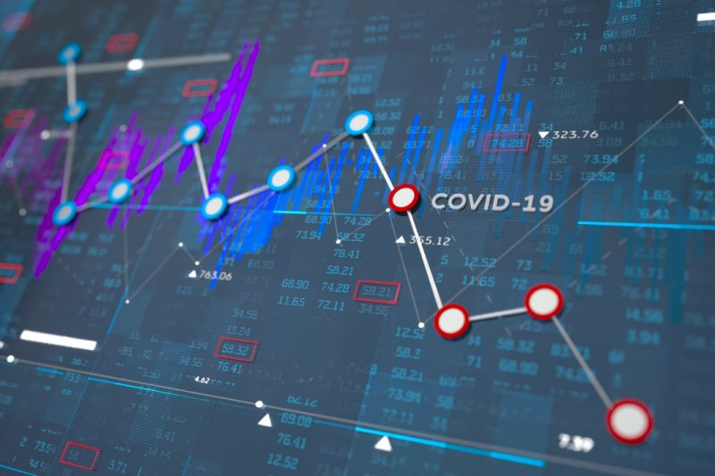
Markets
Interest rates (main topic)
Bonds
Stocks

Slide 3
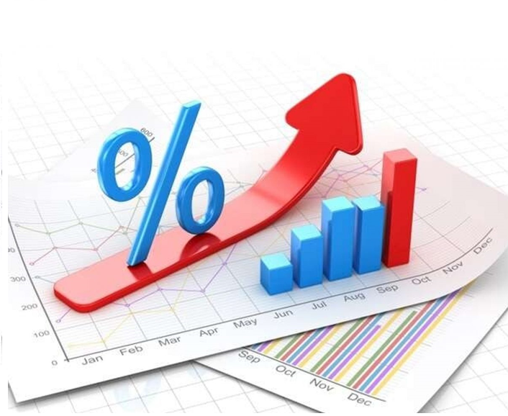
INTEREST RATES
Wherever there is money, an interest rate is also present.

Slide 4
Interest rate components
Real rate
Inflation
Risk
If any of them increase, the interest rate will do the same.

Slide 5
How interest rates affect our lifes?

Slide 6
Compounded interest rates
This means the interest is earned on interest.
Lets see an example:
How much money would you earn at the end of 3 years if you invest $100 today, with a 10% interest rate?

Slide 7
Compounded interest rates
Year | Calculation | Result
0 | 100 | 100
1 | 100*1,10 | 110
2 | 110*1,10 | 121
3 | 121*1,10 | 133,1
FV = 100 * (1+0,10)^3 = $133,1

Slide 8
Compounded interest rates
What if the frequency of the interest rate changes? Lets say, every month
Where “m” is the frequency, in this case, 12 (monthly)
The new result is:

Slide 9
Why this calculations are useful? Lets see this in terms of debt
Assuming your credit card has an anual rate of %18,5 compounded daily (m=12); what is the Effective Anual Rate (EFR)?
So, this means that annually you are actually paying %20,32 of interest rate instead of %18,5. Not such a big change huh?

Slide 10
Lets see a different example:
Someone offers you to lend you $100 for week, and you will only have to pay $5 per week for a total of $105 back to the lender. Sounds good right?
Look closely:
So, the year has 52 weeks, that means m = 52
Then, the interest rate is equal to:
Then, the effective annual rate is:
This is how you can get riped off!!!!

Slide 11
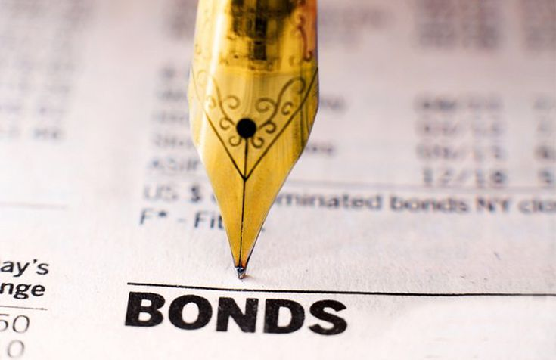
These are debt backed securities that an entity issues in order to fund projects, operations or expansions.

Slide 12
Bonds components
Face Value: the amount of money the bond holder will receive.
Coupon or Coupon Rate: The interest rate paid on the bond.
Maturity: Is the period of the time in which the fase value Will be paid to the bond holder.
Yield to Maturity (YTM): rate of return that incorporates the time value of money. It is determined by the market.
Frequency: It states how frequently in the year interest Will be charged.

Slide 13
Bond Types
Bonds can be traded!
Government
Municipal
Corporate

Slide 14
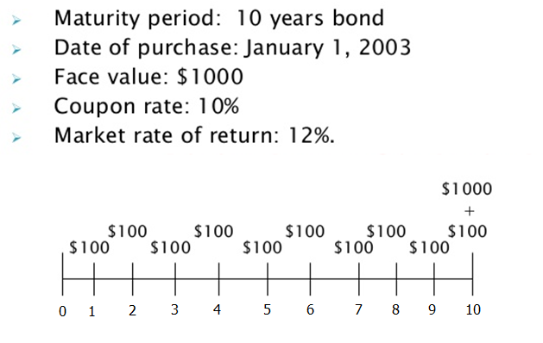
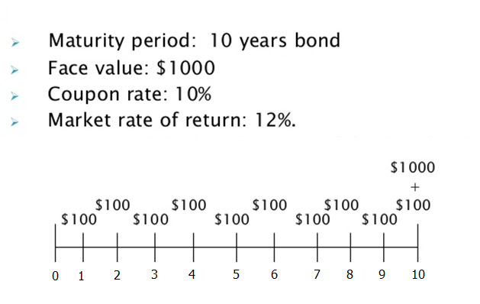
Example
Yield to maturity is a market interest rate
PV (year 0) =
$885.3
PV (year 5) =
$926.4
What if YTM = 8%?
PV (year 5) =
$1,081.1

Slide 15
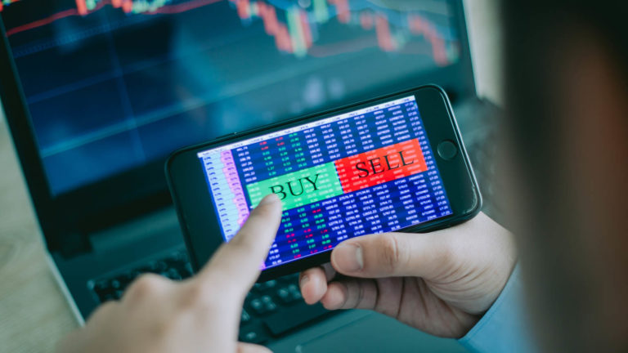
STOCKS
Stock prices also have a calculation that includes an interest rate! When this rate increases, the stock price will decrease and viceversa.

Slide 16
See how important interest rates are?

Slide 17
Financial Concepts
By Esteban Cambronero

